Slide 1
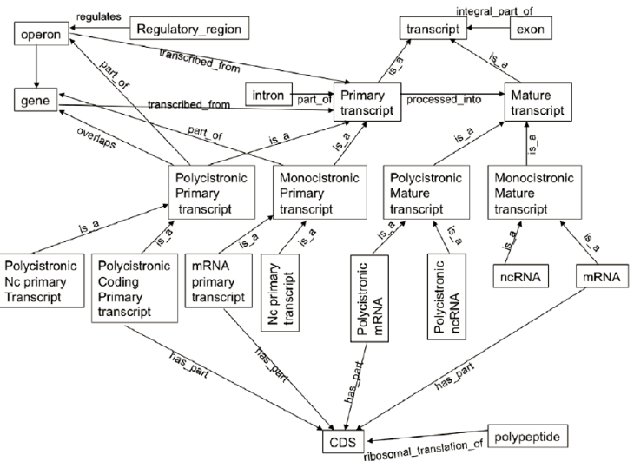
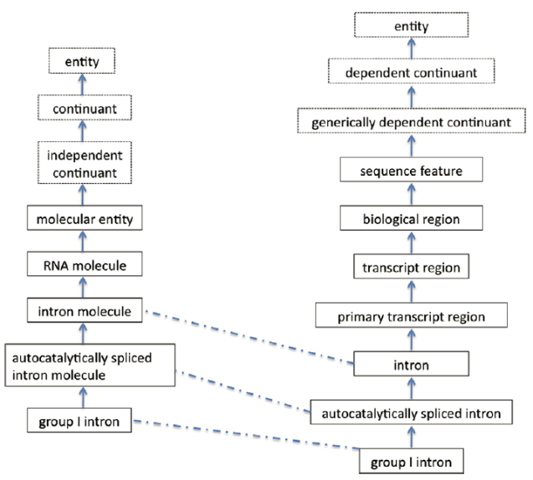
Using the Sequence Ontology
Danger!
Michal Galdzicki
Presentation realies heavily on
Eilbeck, et al. Genome Biology 2005, 6:R44 (doi:10.1186/gb-2005-6-5-r44)

Slide 2
sequenceontology.org
Search
Browse
SO Wiki
Submit Term Request
Definition: “The Sequence Ontology (SO) is a structured controlled vocabulary for the parts of a genomic annotation.”

Slide 3
Sequence Ontology project context
Scope
Description of features and properties of biological sequence
Features
can be located in base coordinates
gene and intron
Properties of features
describe an attribute of the feature
gene may be maternally_imprinted.
Sister project to the Gene Ontology (GO)
Part of the Open Biomedical Ontologies (OBO)

Slide 4
The GenBank force, is strong, within the SO team, it is.
Most terms from GenBank Feature Table map directly to terms in SO
term names may have been changed to fit SO conventions
SO contains a more extensive set of features for detailed annotation
171 features in SOFA
65 in the Feature Table
11 terms in the FT not in SO
Remarks
Immunological features

Slide 5
Why an ontology, what is that?
SO is not a database schema, nor is it a file format; it is an ontology
As such, SO transcends any particular database schema or file format.
This means it can be used equally well as an external data-exchange format or internally as an integral component of a database.
Comfort level, intimate

Slide 6
Honestly, why an ontology? Herbert: Give me one practical reason?
Put an end to needless negotiations between parties as to the details of a data exchange
Eg. GFF3, uses SO terms and definitions to
standardize the feature type
optional attributes to a feature
SOFA Sequence Ontology Feature Annotation
a subset of terms that can be located onto sequence
Eg outputs of automated annotation pipelines
for the markup of gene annotation
SOFA comfort level increase

Slide 7

See slenderman for details
basic types in SOFA, from which other types are defined,
are region and junction
SO uses three basic kinds of relationship between its terms
kind_of, derives_from, and part_of
An enhancer is a kind_of regulatory_region

Slide 8
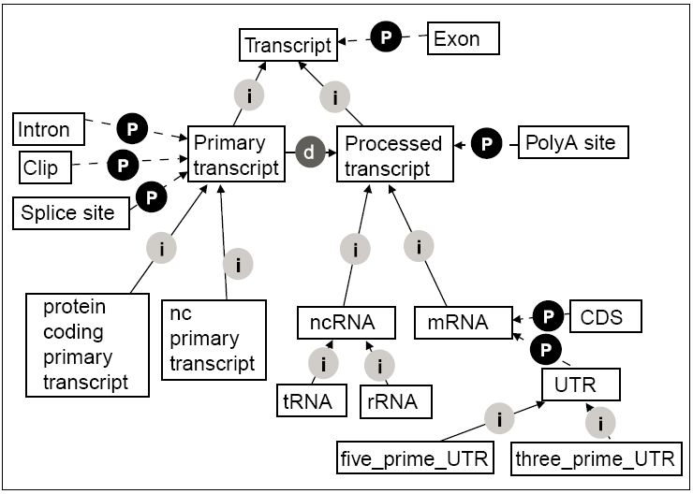
The kind_of relationships are depicted using arrows labeled with 'i', the part_of relationships use arrows with 'P' and the derives_from relationships with 'd'.

Slide 9
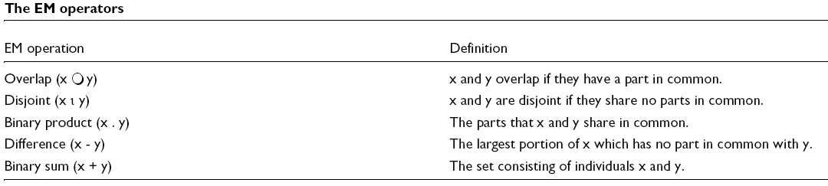
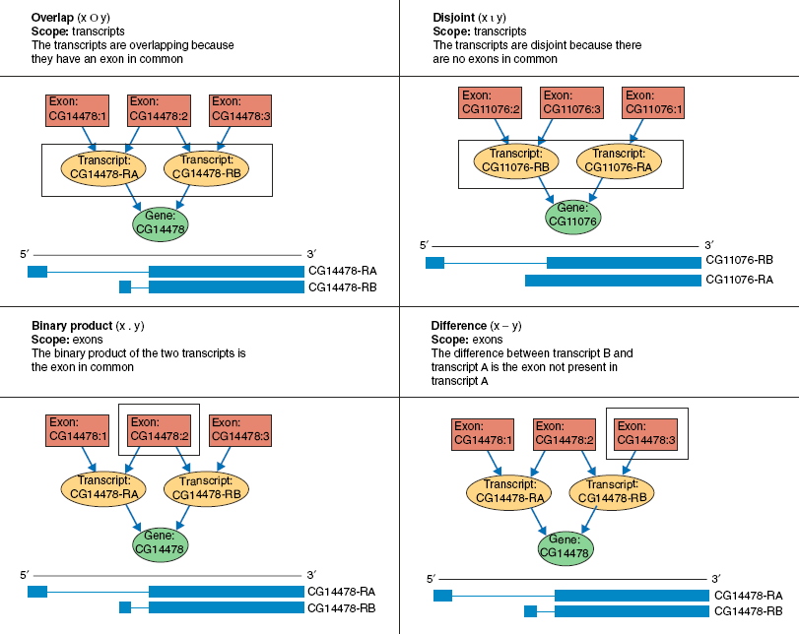
Use extensional mereology (EM) operators to ask questions about gene parts
Exons as alternative parts of transcripts

